Slide 1
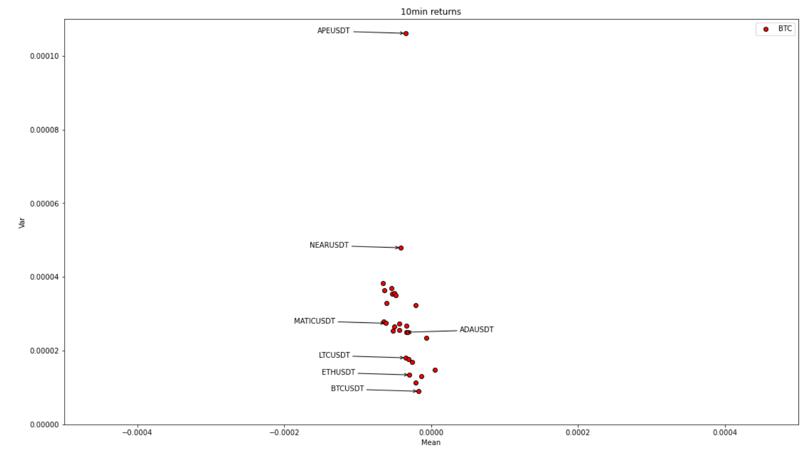
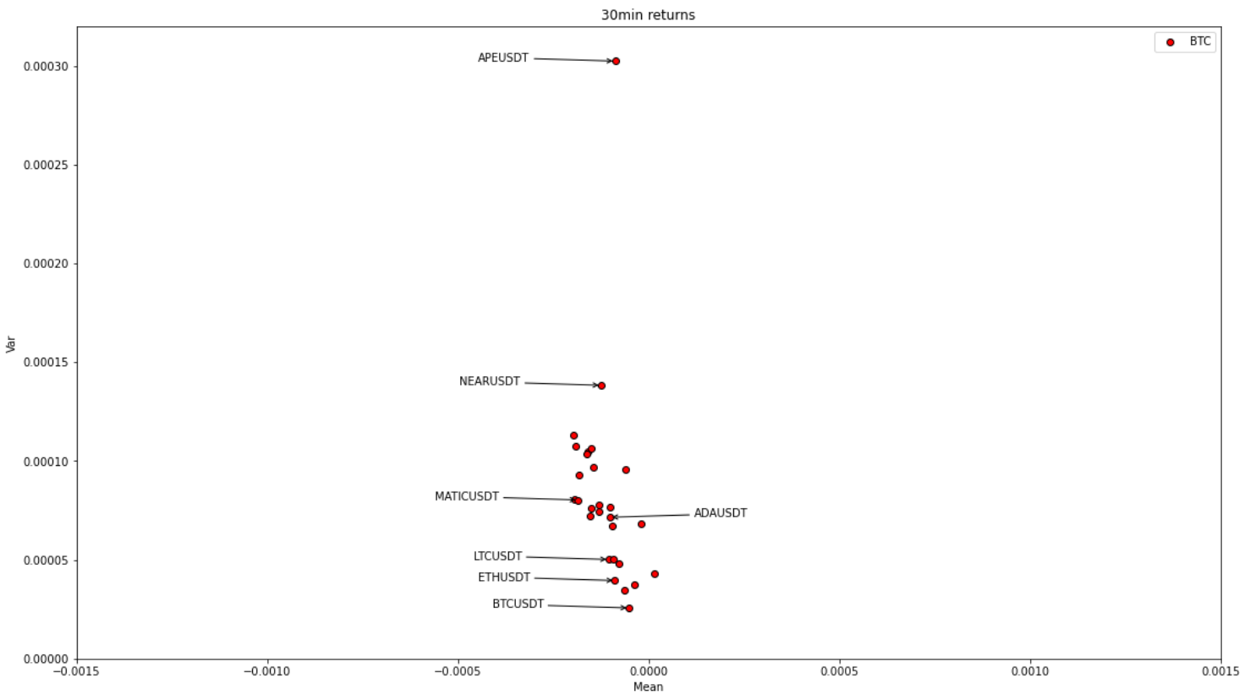
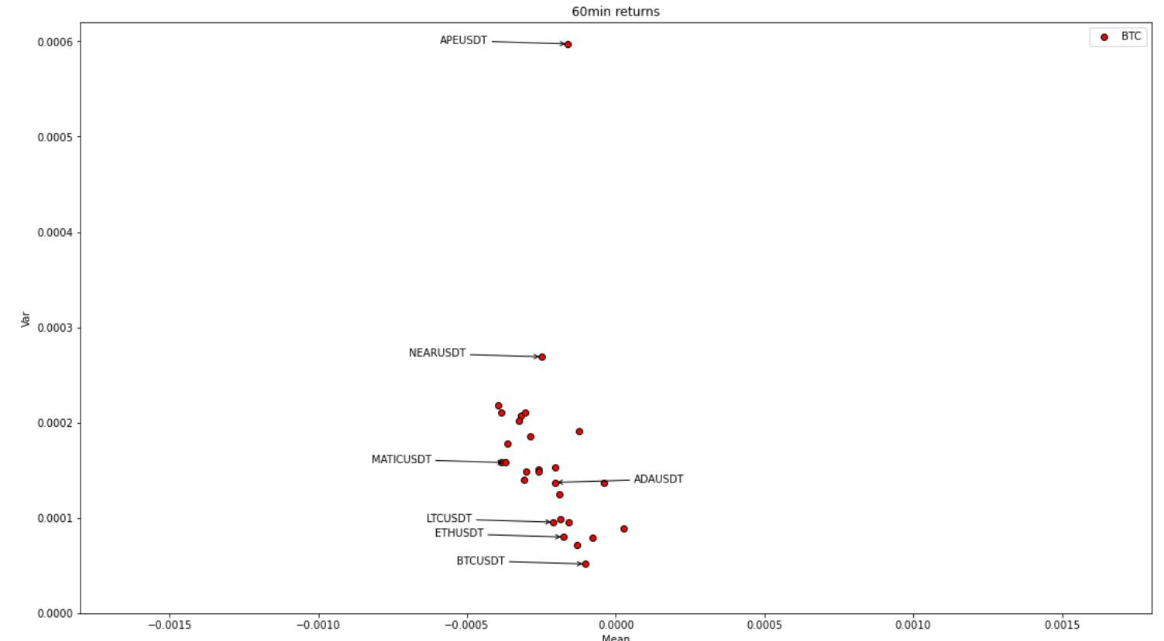
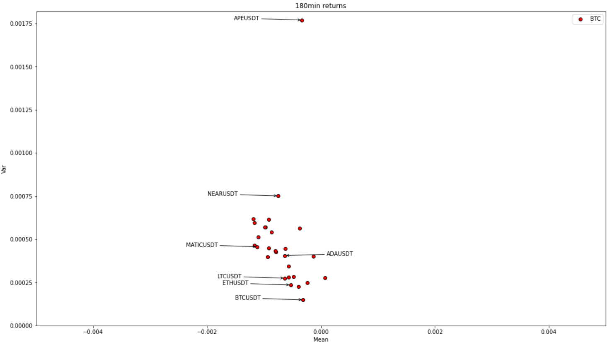
Coin stats (Mean/Var log returns over various return periods)
Consistent relationship
Possible grouping
Clear differentiation in variance
Note different scales in plots

Slide 2
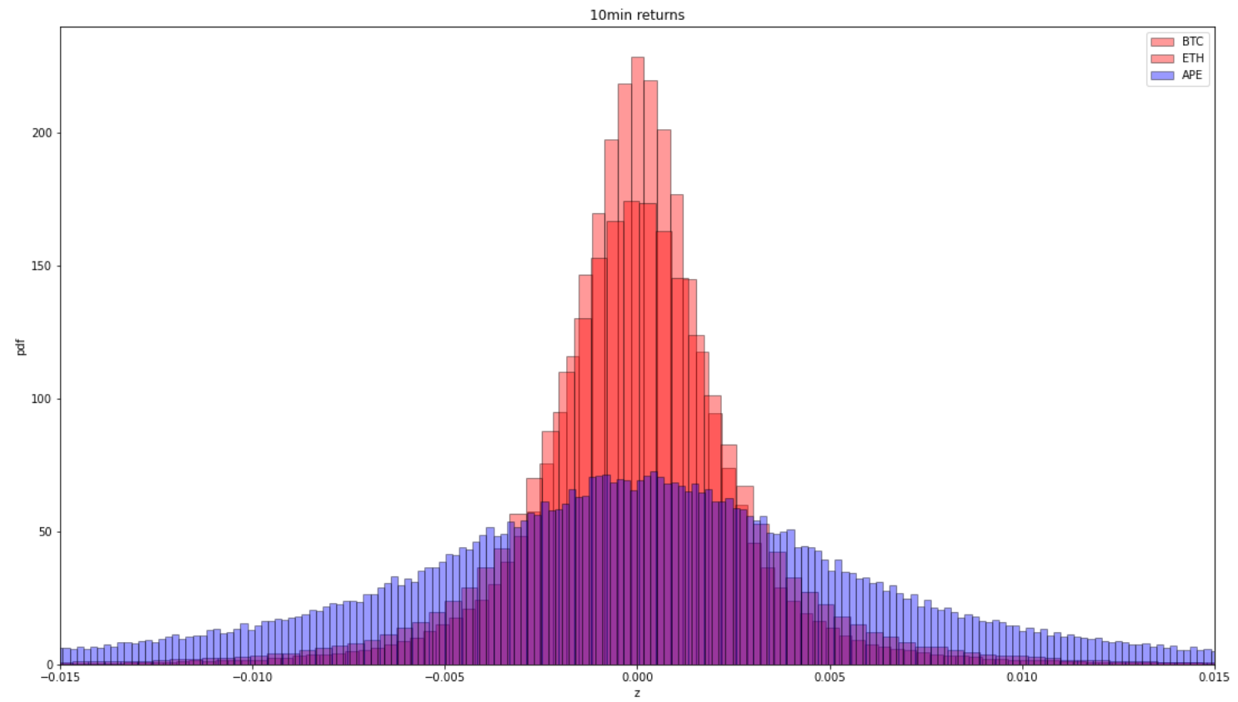
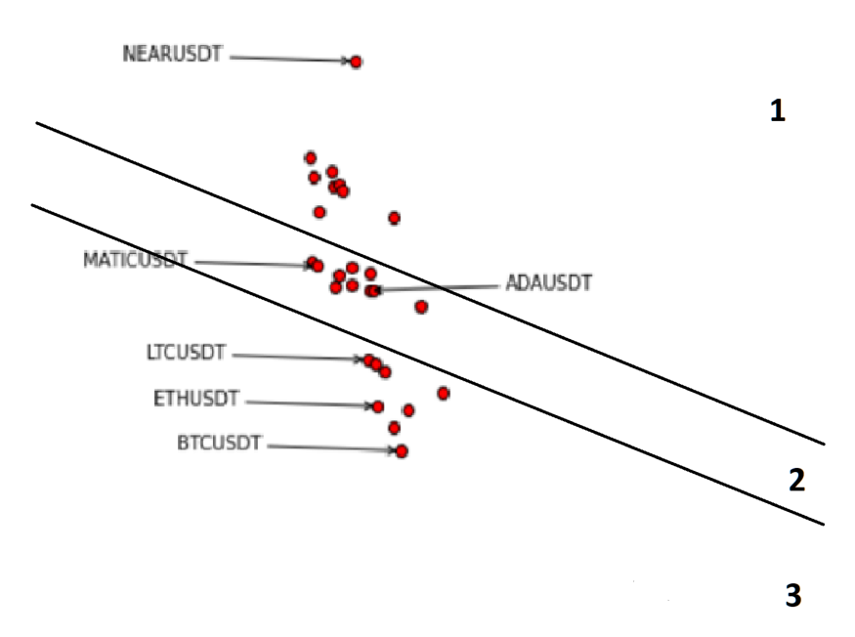
Coin stats (Simple histogram)
Possible groups

Slide 3
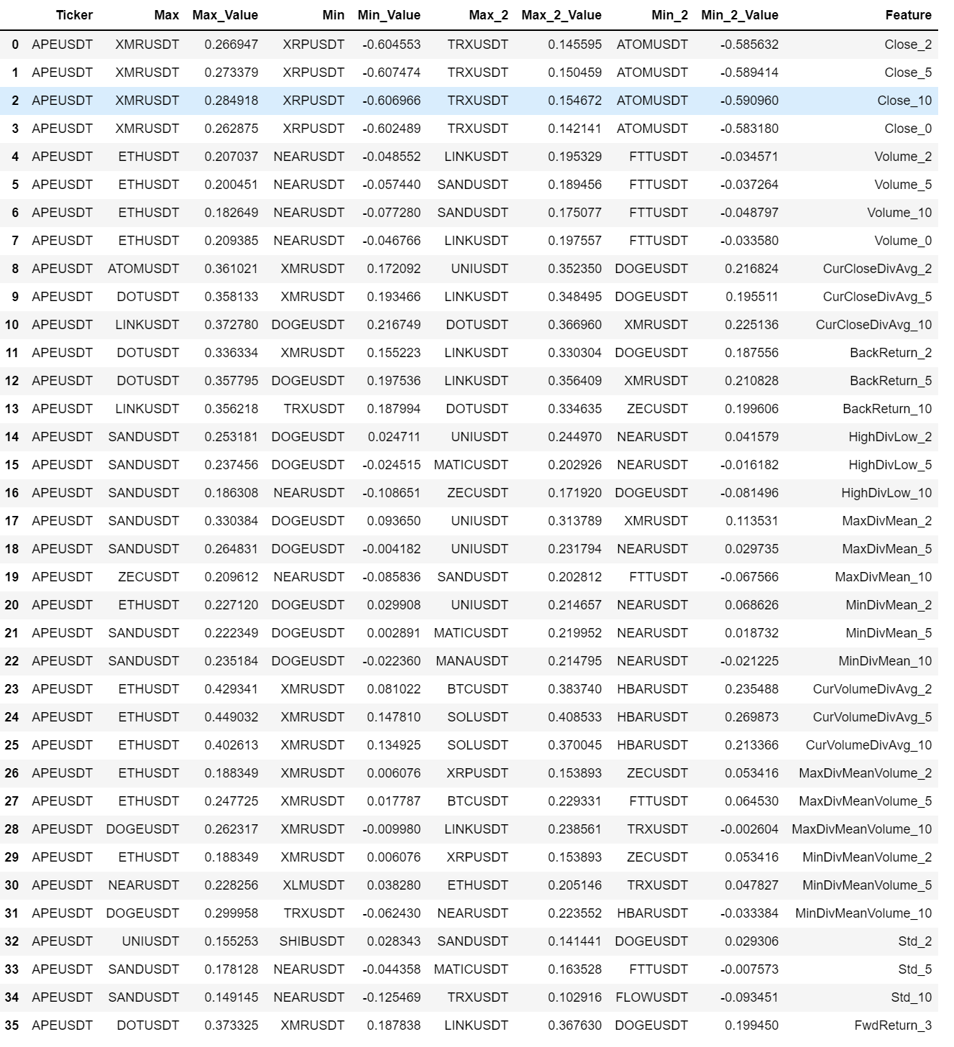
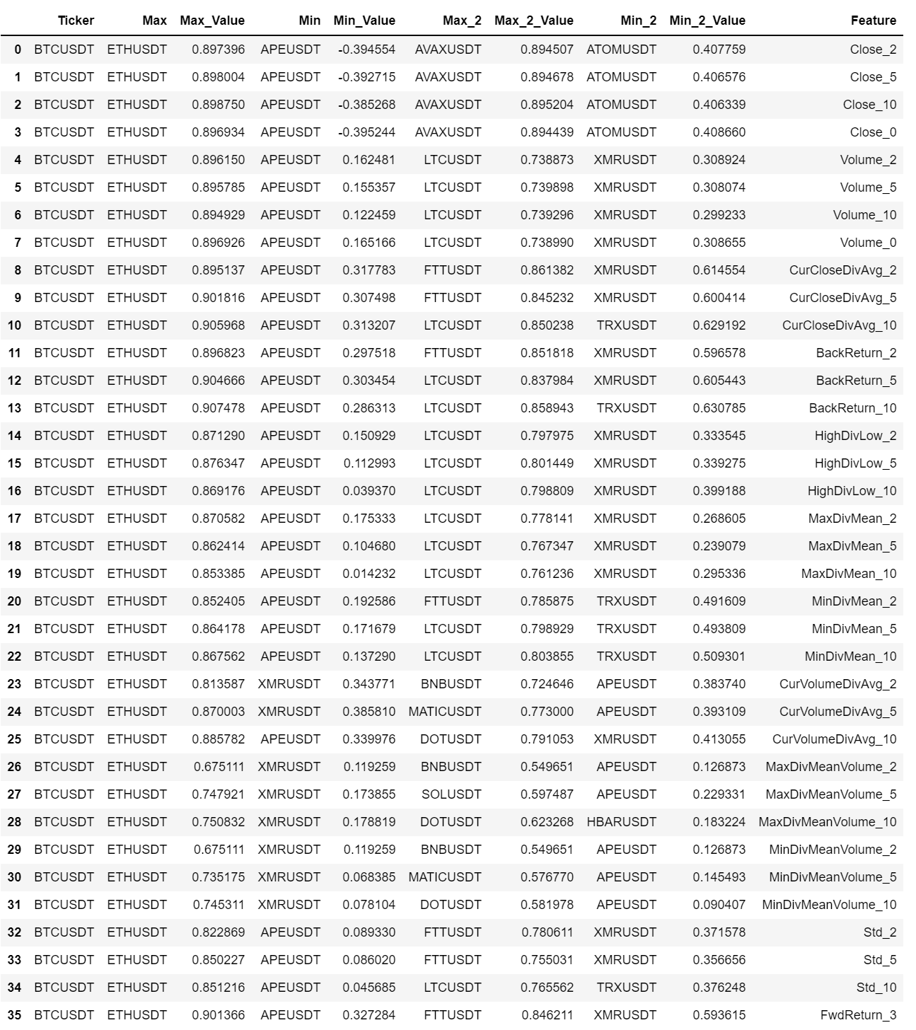
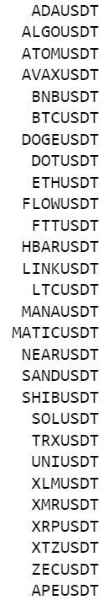
Correlation analysis
1 Hour interval.
Scope

Slide 4
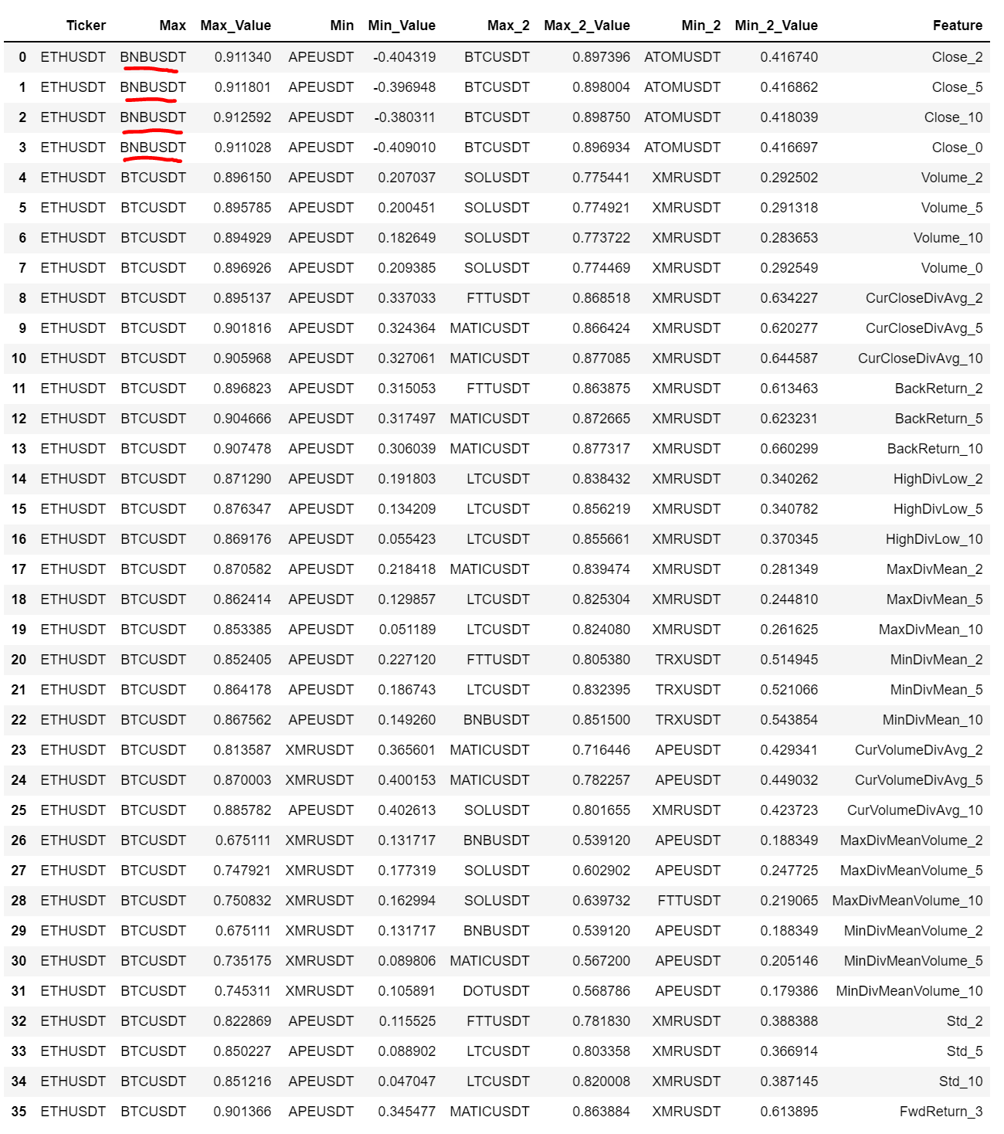
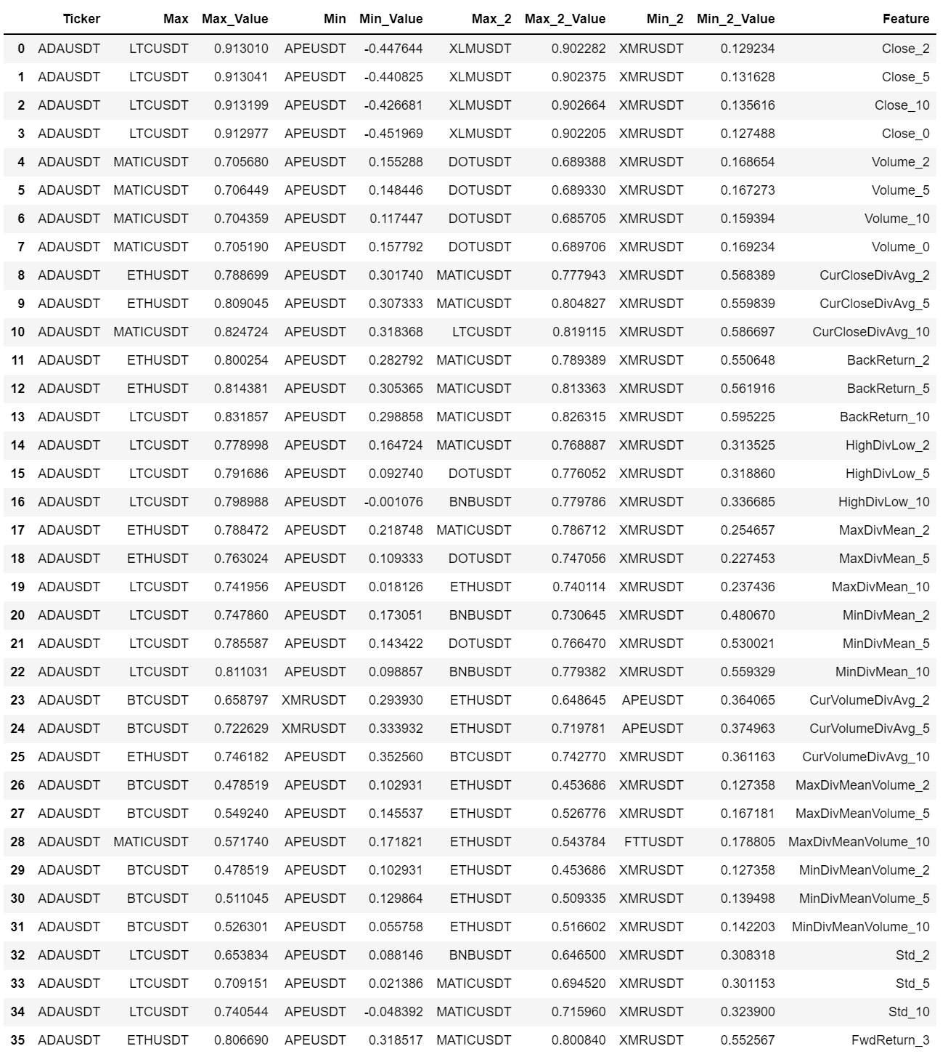
Correlation analysis
1 Hour interval.

Slide 5
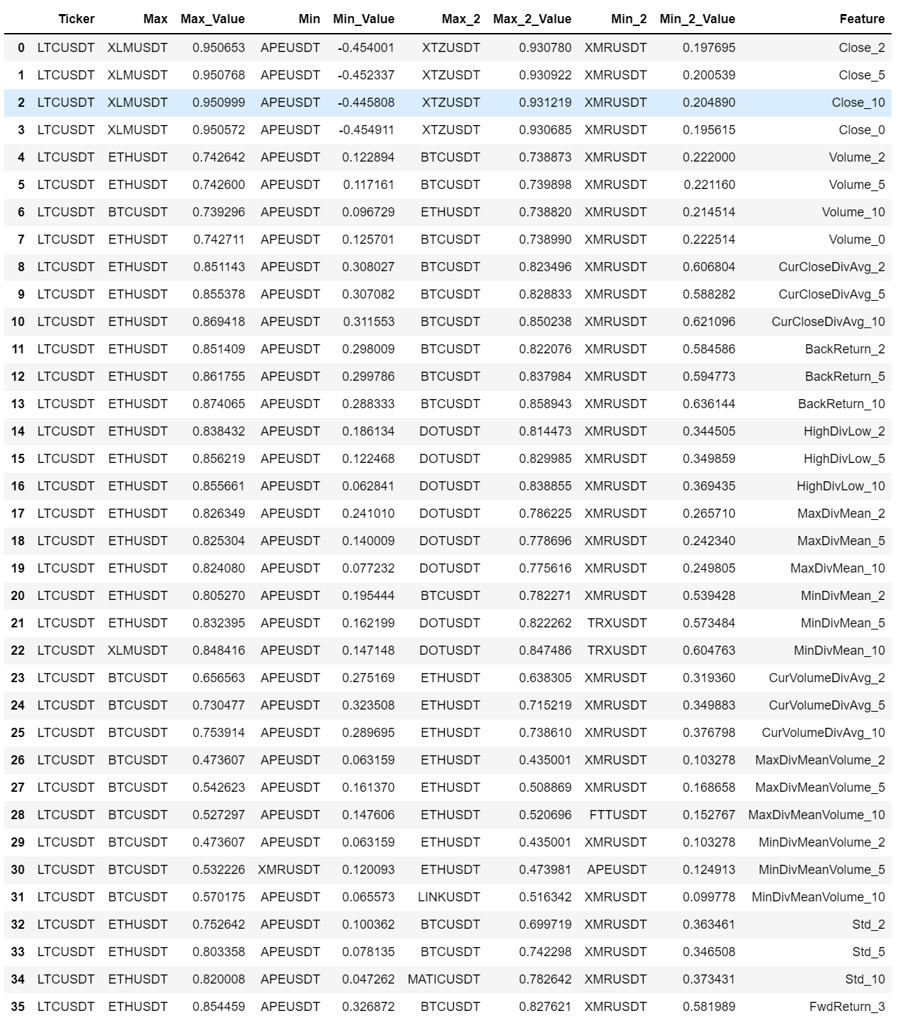
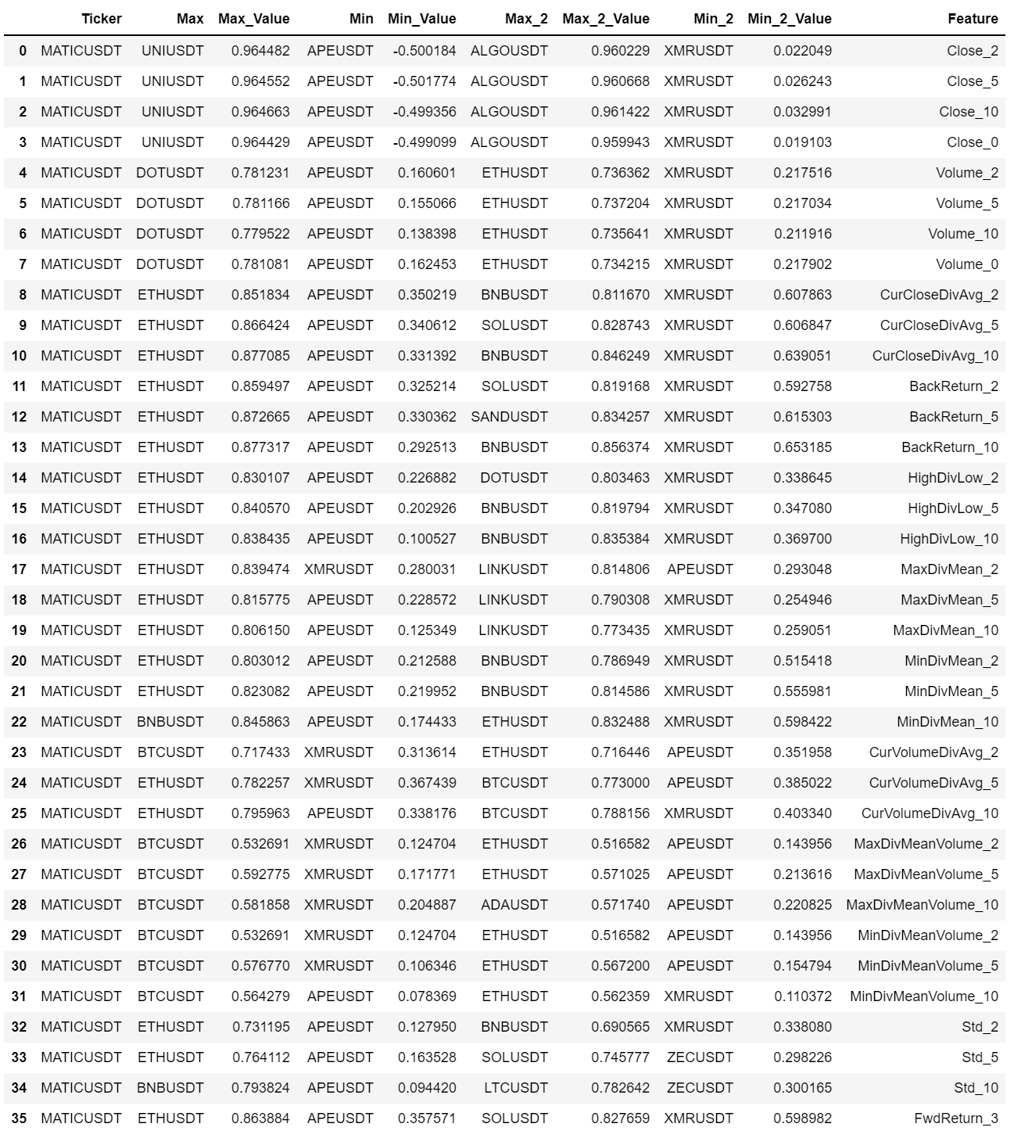
Correlation analysis
1 Hour interval.

Slide 6
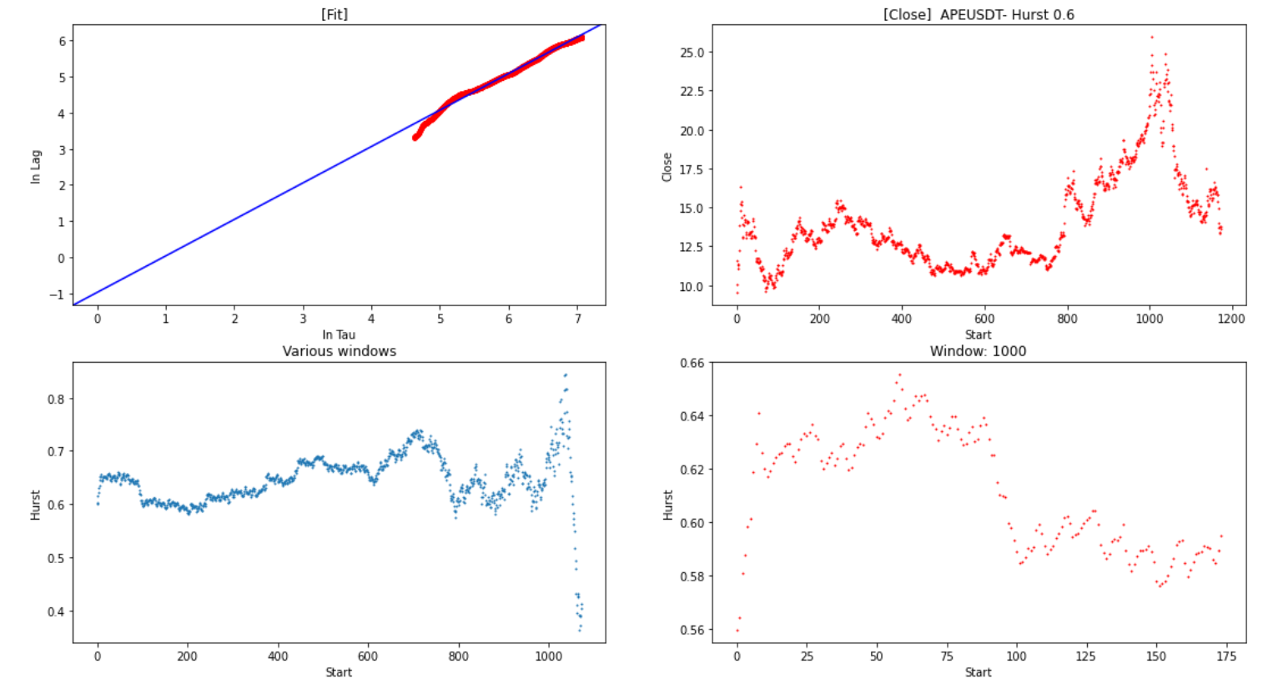
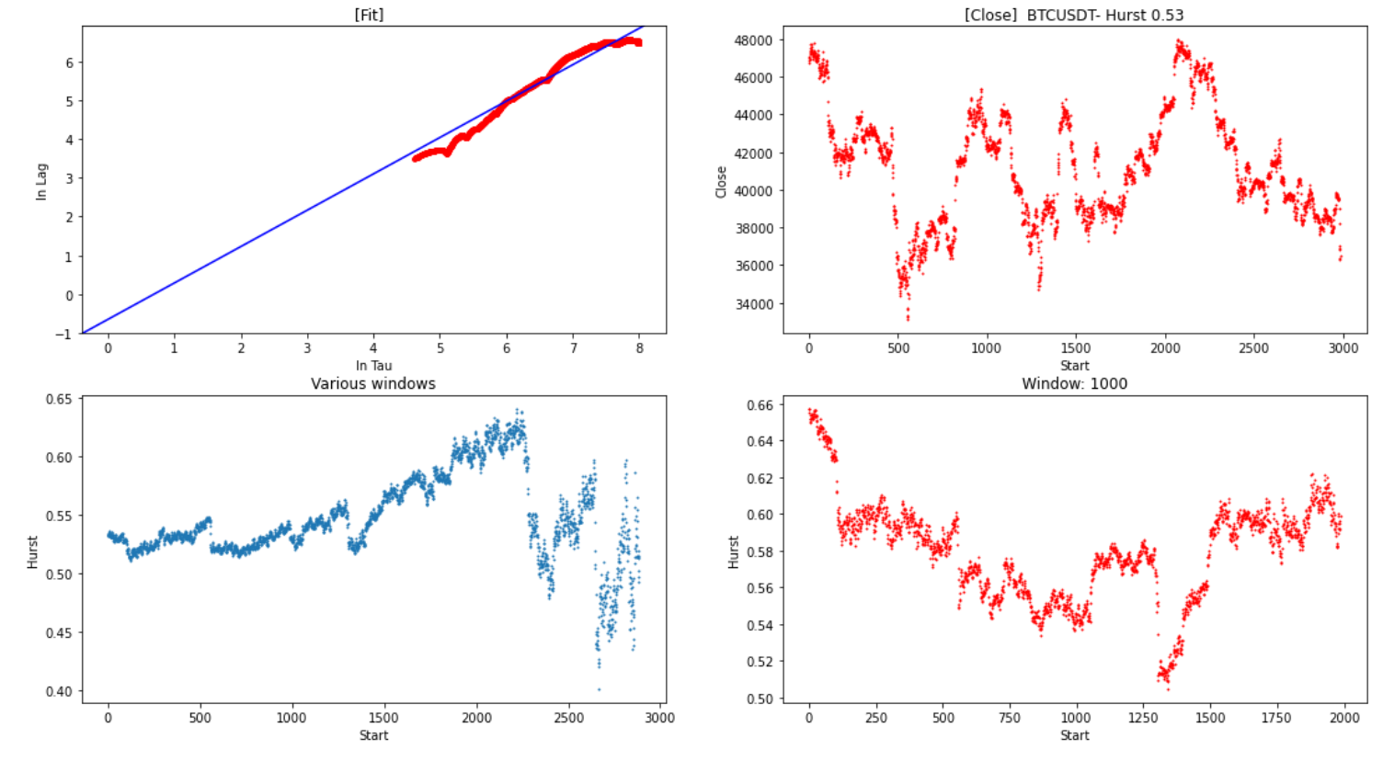
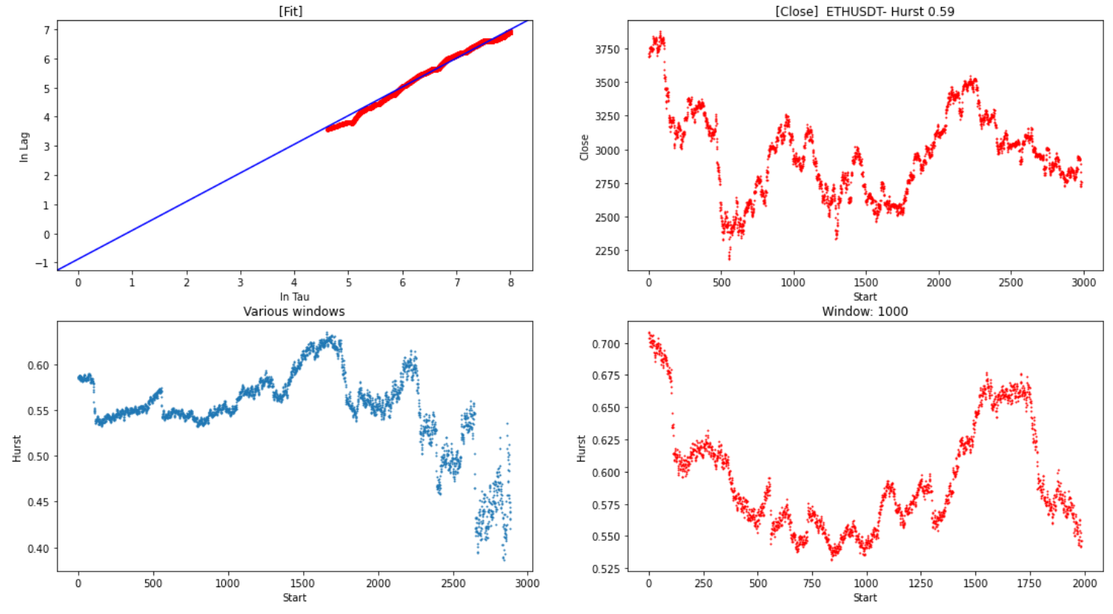
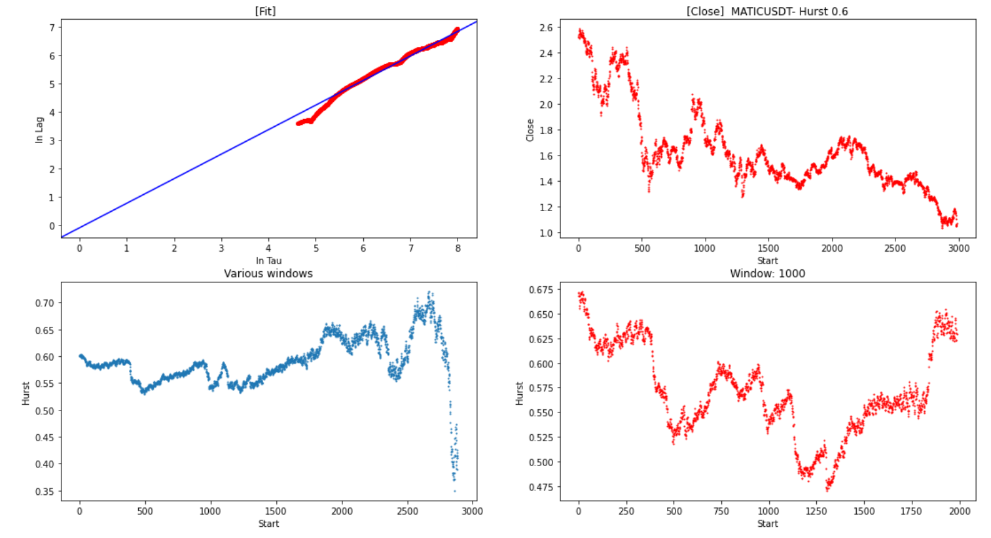
Hurst Analysis:
1 Hour intervals
BTC
APE
ETH
MATIC

Slide 7
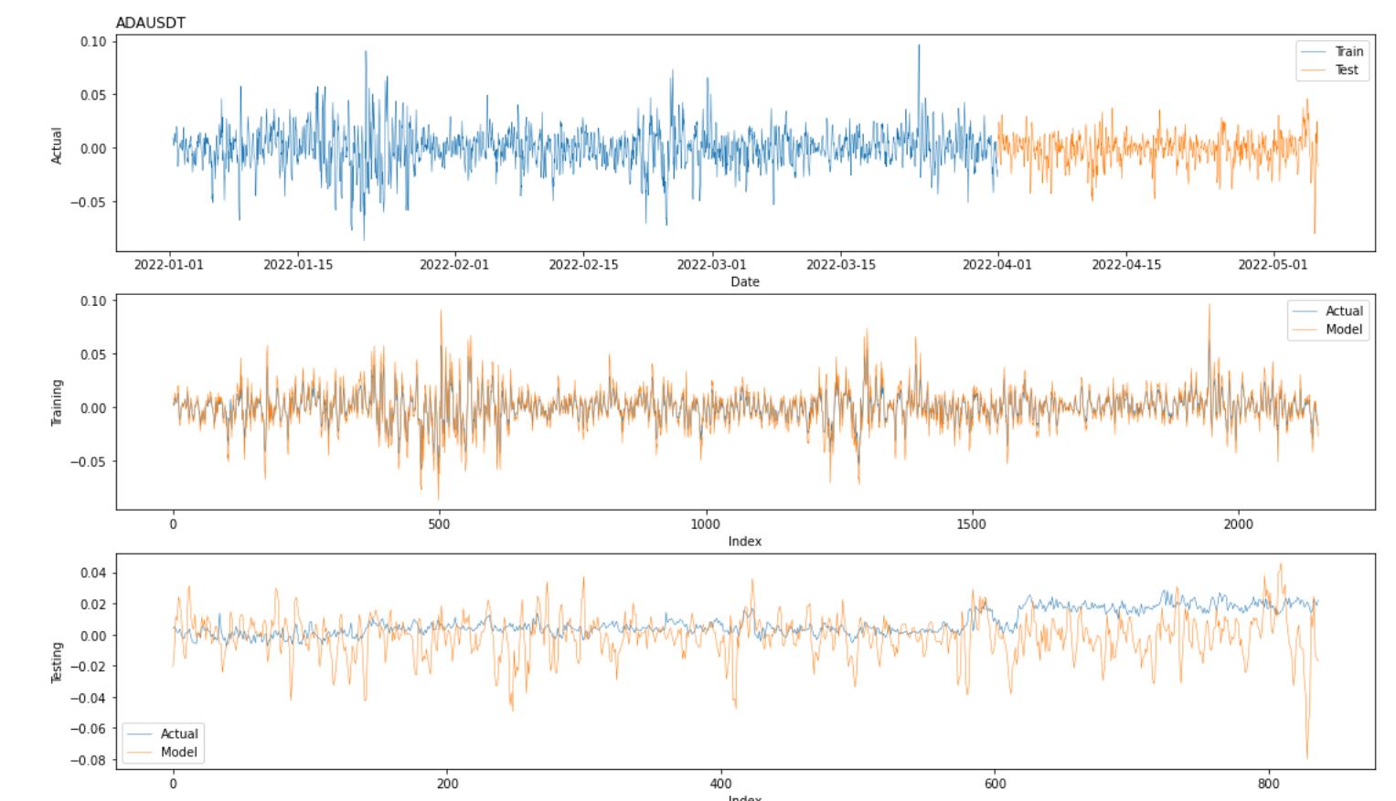
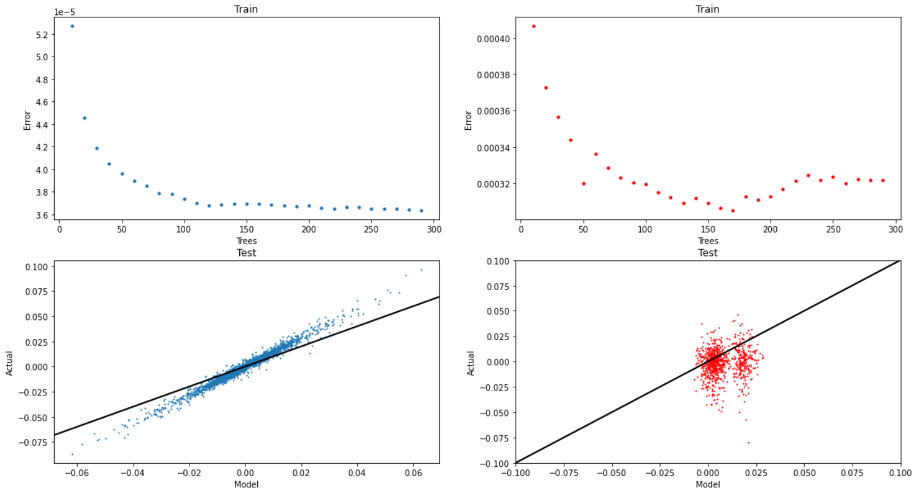
Random Forest
1 Hour intervals
Primary: ADAUSDT
Forecast: FwdReturn 3 hrs
Train to 4th April
Include: 'ETHUSDT','MATICUSDT’
All features.
150 Trees

Slide 8
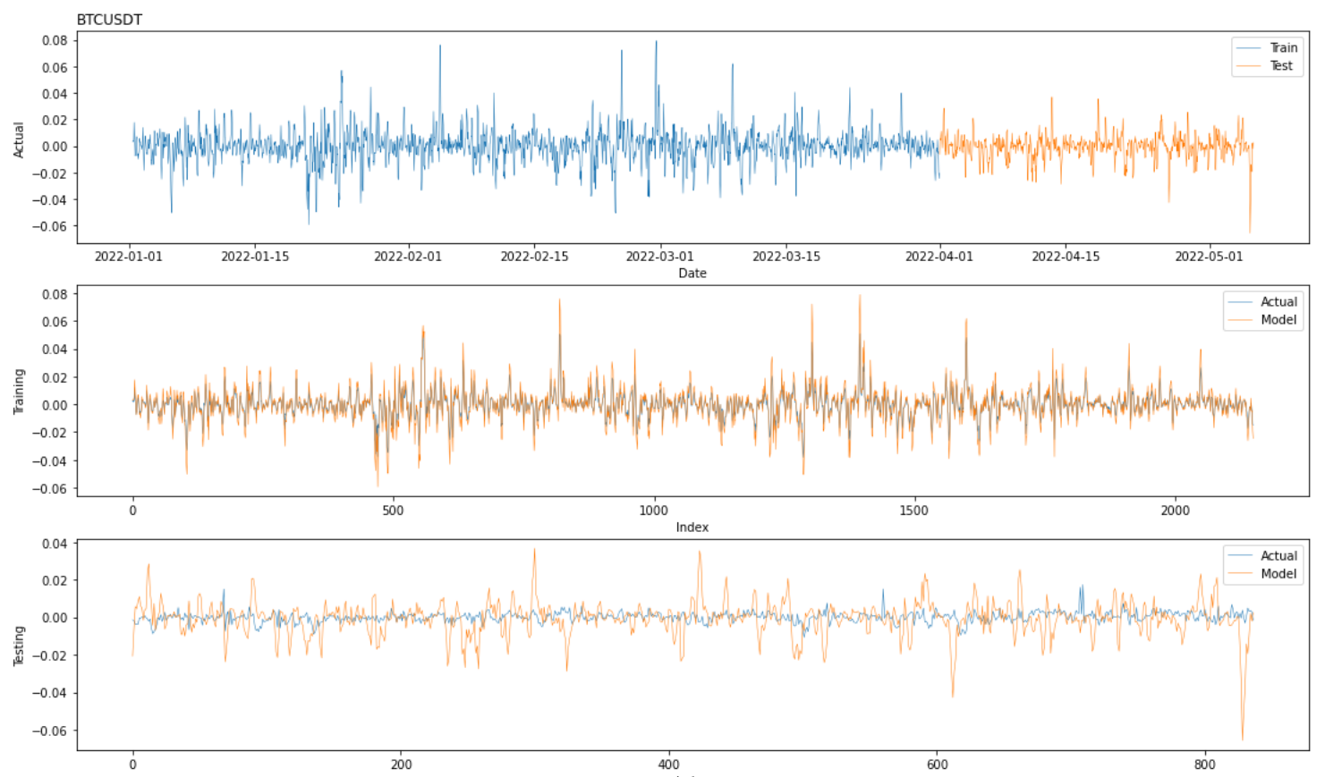
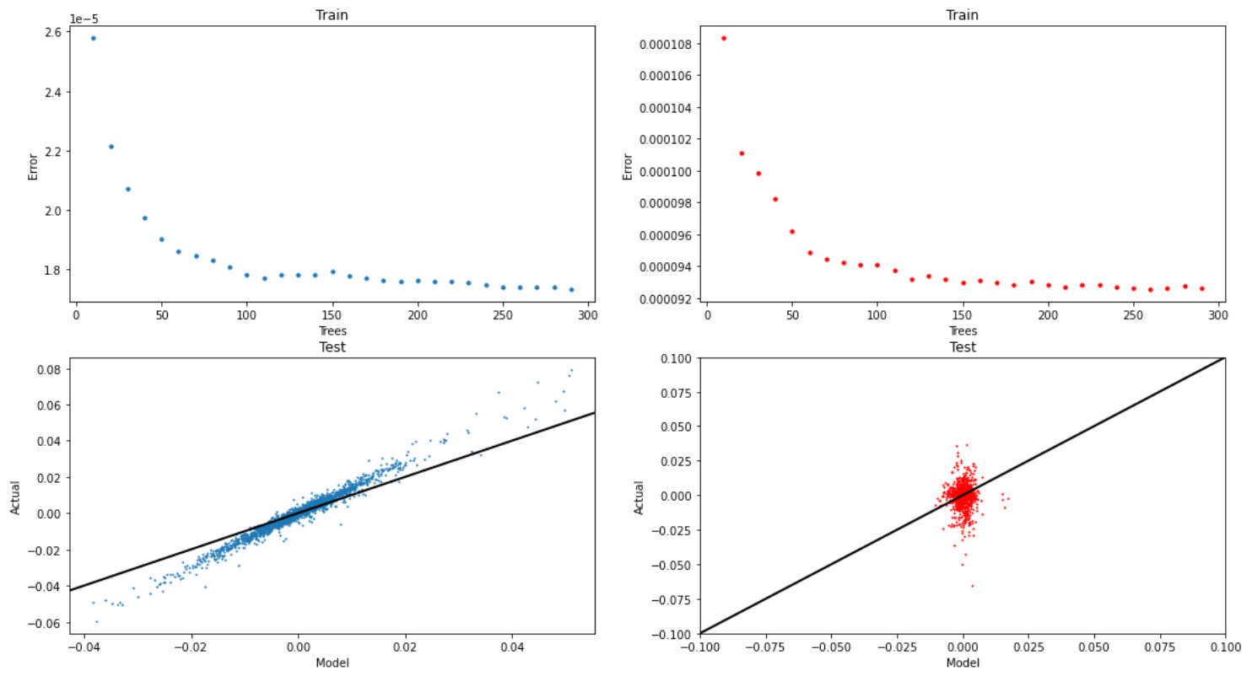
Random Forest
1 Hour intervals
Primary: BTCUSDT
Forecast: FwdReturn 3 hrs
Train to 4th April
Include: 'ETHUSDT'
All features.
150 Trees

Slide 9
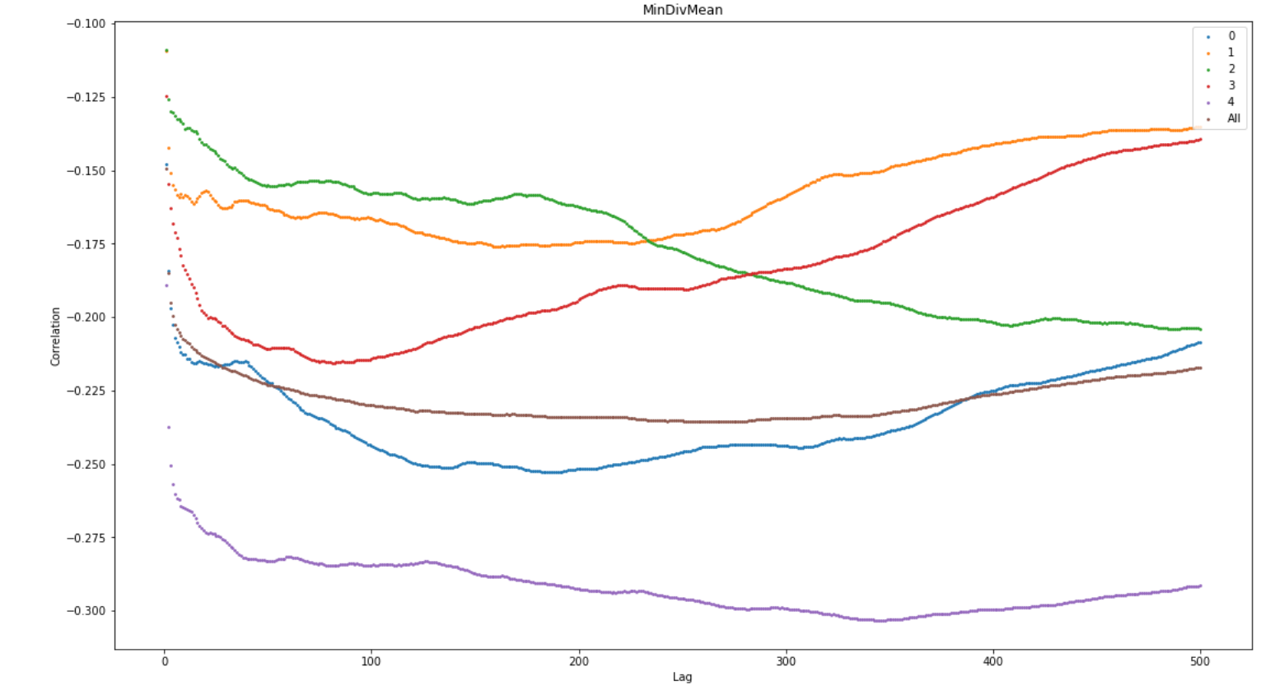
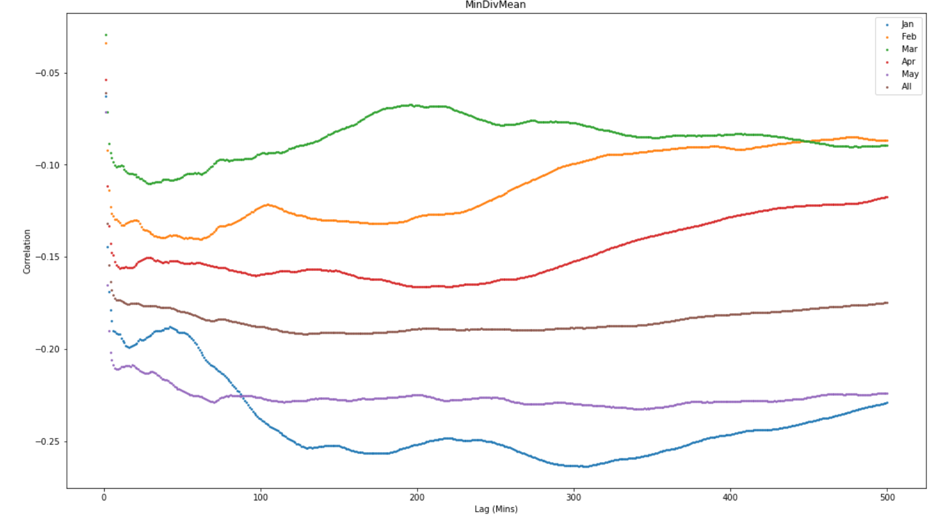
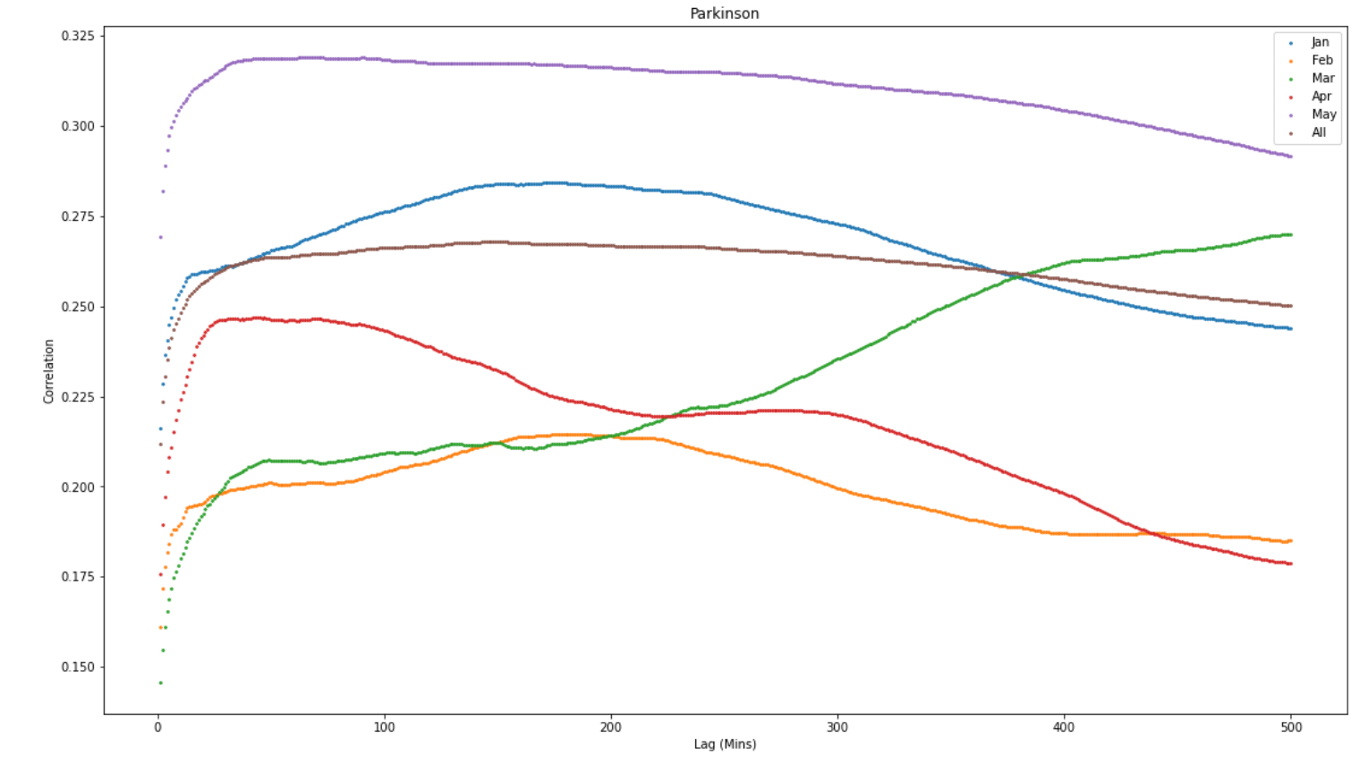
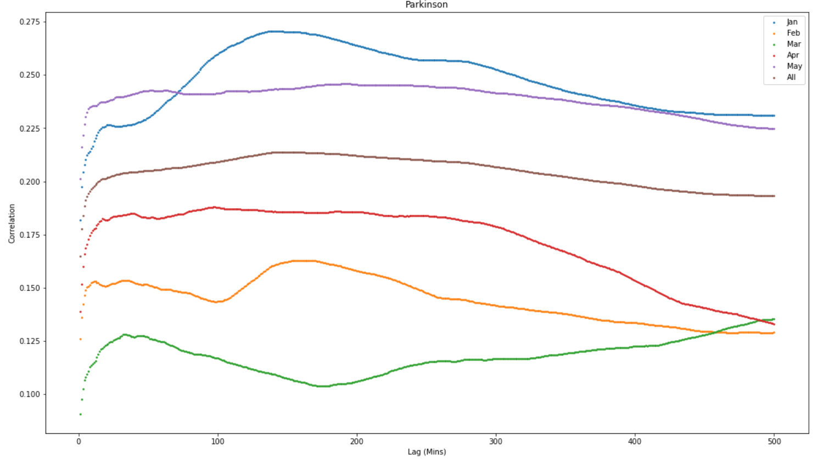
Feature correlation (Capital Return% > 0.9%)
Skew ~ 44%
Feature correlation (Capital Return% > 2%)
Skew ~ 12%

Slide 10
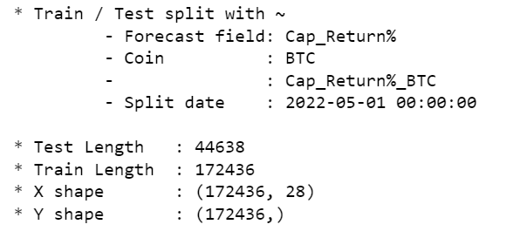
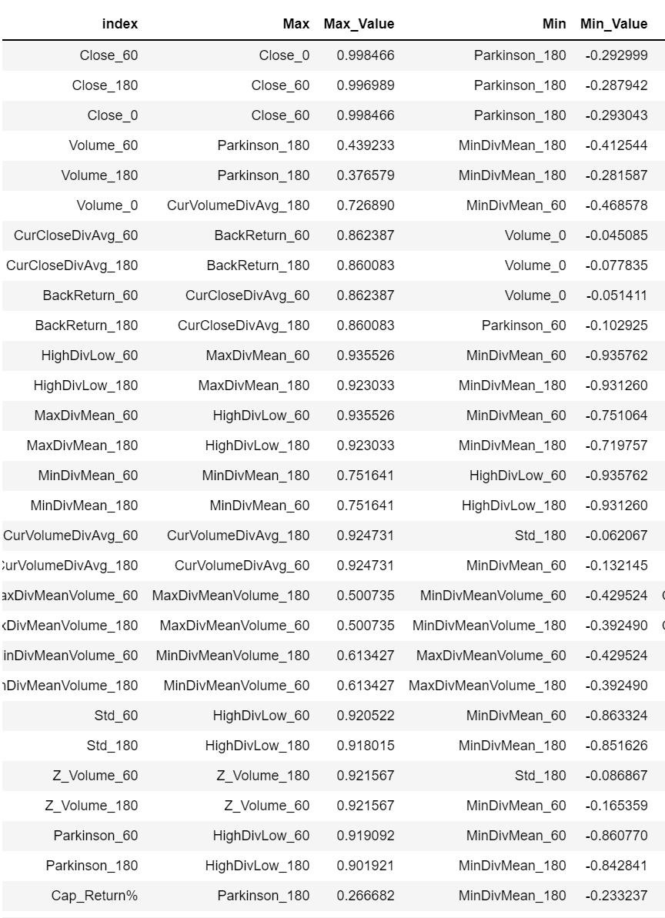
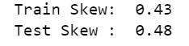
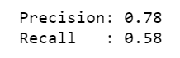
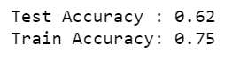
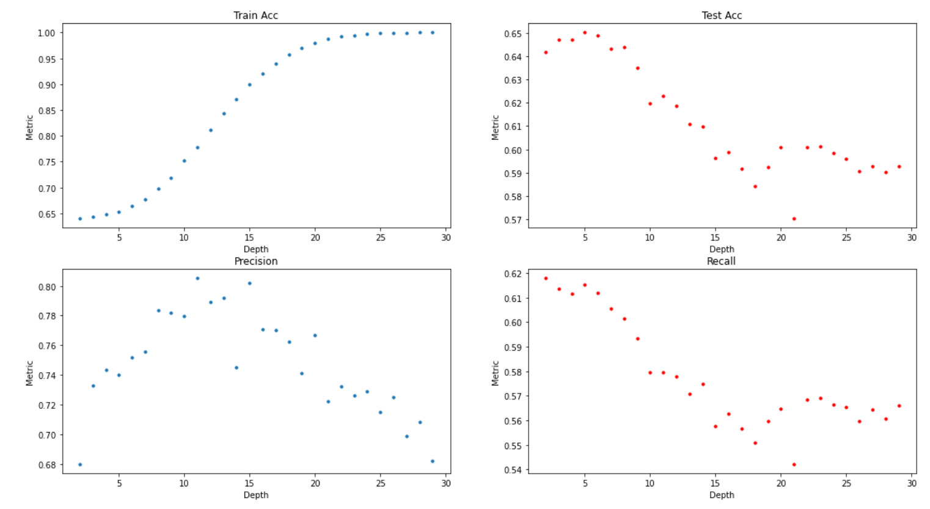
Feature correlation (Capital Return% > 0.9%)
Skew ~ 44%
Train Jan/Feb ../April
Test May
Random Forest Classifier
Depth 10
Trees: 60

